Slide 1
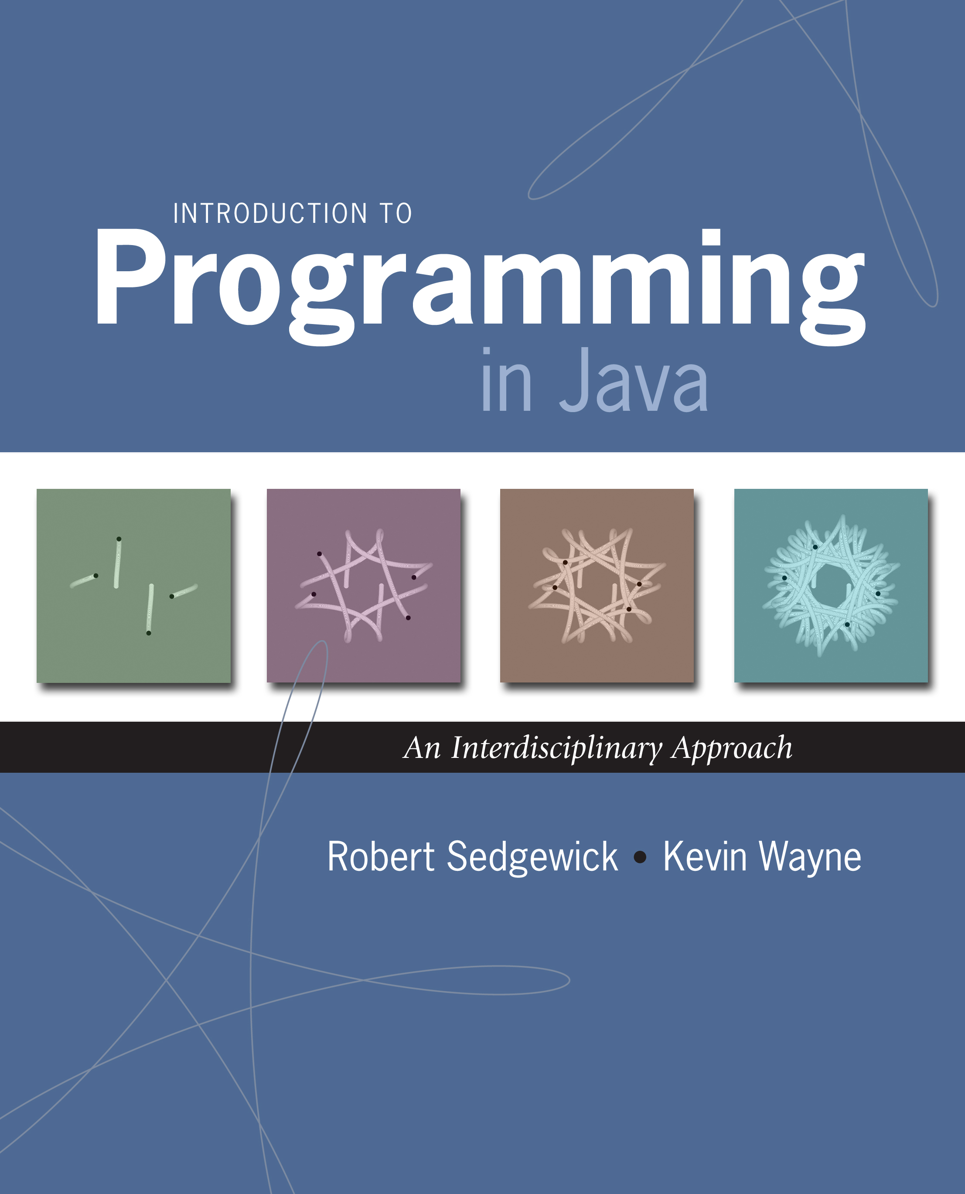
3.1 Using Data Types (I)
Introduction to Programming in Java: An Interdisciplinary Approach · Robert Sedgewick and Kevin Wayne · Copyright © 2002–2010 · 11/3/15 2:03:41 PM

Slide 2
A Foundation for Programming
any program you might want to write
objects
create your own data types
functions and modules
graphics, sound, and image I/O
arrays
conditionals and loops
Math
text I/O
primitive data types
assignment statements
Notes:
Can accomplish a huge amount with loops, conditionals, arrays, and functions. Can use any language, such as Matlab, Perl, or Java for this.
To build larger programs, need more discipline. Java supports object-oriented programming to support "programming in the large".
OOP = discipline of how to write programs

Slide 3
Data Types
Data type. Set of values and operations on those values.
Primitive types. Values directly map to machine representation; ops directly map to machine instructions.
We want to write programs that process other types of data.
Colors, pictures, strings, input streams, …
Complex numbers, vectors, matrices, polynomials, …
Points, polygons, charged particles, celestial bodies, …
Data Type
Set of Values
Operations
boolean
true, false
not, and, or, xor
int
-2³¹ to 2³¹ - 1
add, subtract, multiply
double
any of 2⁶⁴ possible reals
add, subtract, multiply
Notes:
Organizing a big software project is a highly nontrivial task. What would you do to manage dozens of programmers working on the same project? Creating medium or large pieces of software requires careful organization and structure. Our goal will be to divide the project into smaller independent modules with clean and simple interfaces.
more data types: Lists, playing cards, datasets, particles, sound waves, GUIs, . . .

Slide 4
Objects
Object. Holds a data type value; variable name refers to object.
Object-oriented programming.
Create your own data types (set of values and ops on them).
Use them in your programs (manipulate objects that hold values).
This lecture. Use existing data types.
Next lecture. Create your own data types.
Data Type
Set of Values
Operations
Color
24 bits
get red component, brighten
Picture
2D array of colors
get/set color of pixel (i, j)
String
sequence of characters
length, substring, compare
Notes:
Arrays are also object data types (with some built-in language support, e.g., a[i] is the ith value in array)

Slide 5
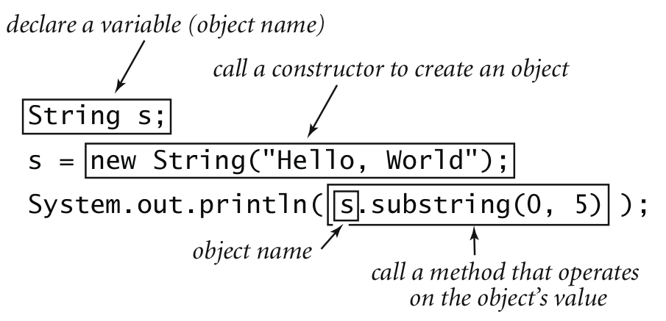
Constructors and Methods
To construct a new object:
Use keyword new (to invoke constructor).
Use name of data type (to specify which type of object).
To apply an operation:
Use name of object (to specify which object).
Use the dot operator (to invoke method).
Use the name of the method (to specify which operation).
Notes:
Note: s = "Hello, World" is (mostly) syntactic sugar.

Slide 6
Image Processing

Slide 7
Color Data Type
Color. A sensation in the eye from electromagnetic radiation.
Set of values. [RGB representation] 256³ possible values, which quantify the amount of red, green, and blue, each on a scale of 0 to 255.
R
G
B
Color
255
0
0
0
255
0
0
0
255
255
255
255
0
0
0
255
0
255
105
105
105
Notes:
approximately 16.7 million colors. Typical for monitors. More than human eye can distinguish, but RGB color space not the same as human eye color space
color is not perception independent; (OK, color is not the only sensation from electromagnetic radiation. Better definition?)
tie to int
RGB This format is commonly used in television screens, computer monitors, digital cameras, and web pages.
NB: in Java a color is actually represented using a 32 bit int, 4 bits for R, G, B. the last 4 bits are used for transparency (alpha channel)

Slide 8
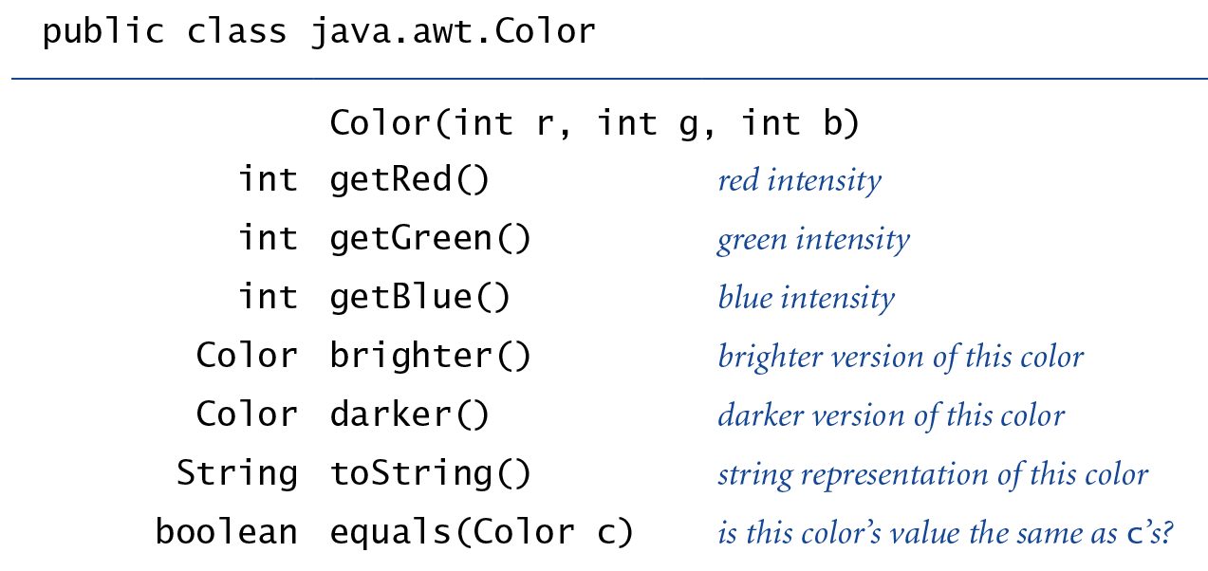
Color Data Type
Color. A sensation in the eye from electromagnetic radiation.
Set of values. [RGB representation] 256³ possible values, which quantify the amount of red, green, and blue, each on a scale of 0 to 255.
API. Application Programming Interface.
http://download.oracle.com/javase/6/docs/api/java/awt/Color.html

Slide 9
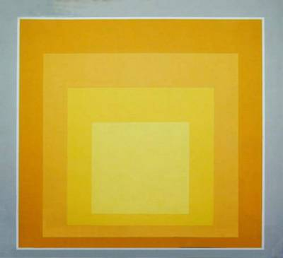
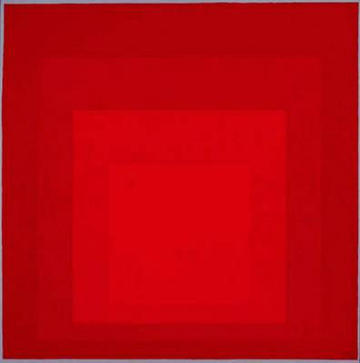
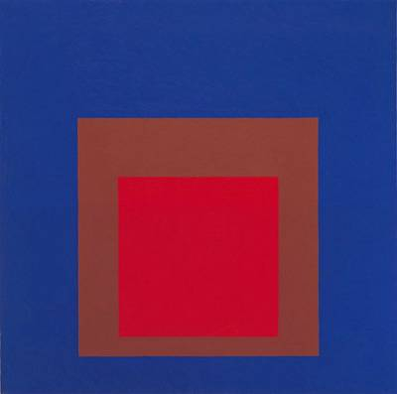
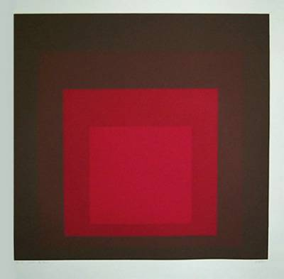
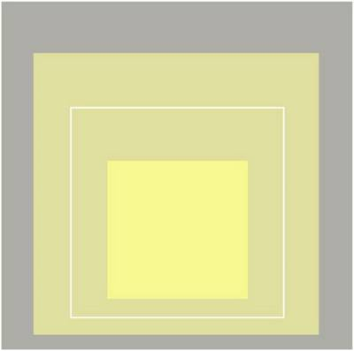
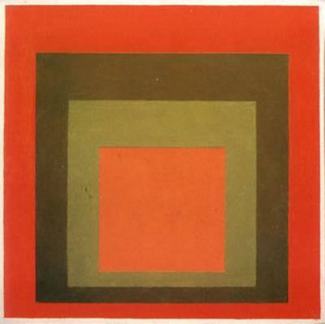
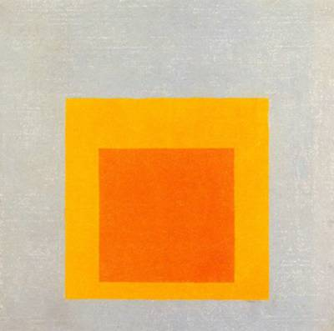
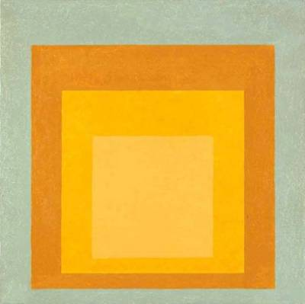
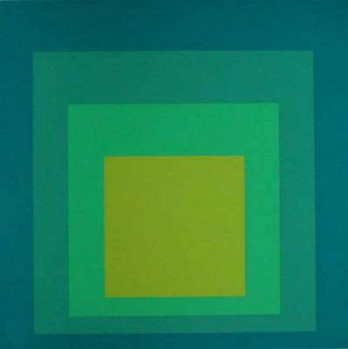
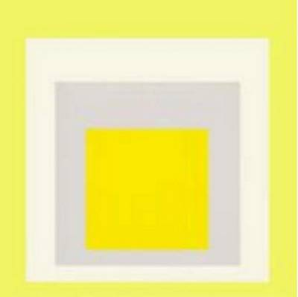
Albers Squares
Josef Albers. Revolutionized the way people think about color.
Homage to the Square by Josef Albers (1949-1975)
Notes:
artist and educator.
Albers explored chromatic interactions with flat colored squares arrange concentrically
"for exploring the subjective experience of color—the effects that adjacent colors have on one another, for example, and the illusion of flat planes of color advancing or receding in space."

Slide 10

Albers Squares
Josef Albers. Revolutionized the way people think about color.
blue
gray
% java AlbersSquares 9 90 166 100 100 100

Slide 11
Using Colors in Java
import java.awt.Color;
public class AlbersSquares {
public static void main(String[] args) {
int r1 = Integer.parseInt(args[0]);
int g1 = Integer.parseInt(args[1]);
int b1 = Integer.parseInt(args[2]);
Color c1 = new Color(r1, g1, b1);
int r2 = Integer.parseInt(args[3]);
int g2 = Integer.parseInt(args[4]);
int b2 = Integer.parseInt(args[5]);
Color c2 = new Color(r2, g2, b2);
StdDraw.setPenColor(c1);
StdDraw.filledSquare(.25, .5, .2);
StdDraw.setPenColor(c2);
StdDraw.filledSquare(.25, .5, .1);
StdDraw.setPenColor(c2);
StdDraw.filledSquare(.75, .5, .2);
StdDraw.setPenColor(c1);
StdDraw.filledSquare(.75, .5, .1);
}
}
to access Color library
first color
second color
first square
second square
Notes:
One use of objects. Store aggregate data in one variable.

Slide 12
Monochrome Luminance
Monochrome luminance. Effective brightness of a color.
NTSC formula. Y = 0.299r + 0.587g + 0.114b.
import java.awt.Color;
public class Luminance {
public static double lum(Color c) {
int r = c.getRed();
int g = c.getGreen();
int b = c.getBlue();
return .299*r + .587*g + .114*b;
}
}
Notes:
NTSC formula for converting an RGB image to grayscale, derived from the eye's sensitivity to red, green, and blue
Illustrates a function involving objects. Don't need to pass (r, g, b) to function. Can't return more than one value from a function.

Slide 13
Color Compatibility
Q. Which font colors will be most readable with which background colors on computer and cell phone screens?
A. Rule of thumb: difference in luminance should be ≥ 128.
255
208
105
47
28
14
public static boolean compatible(Color a, Color b) {
return Math.abs(lum(a) - lum(b)) >= 128.0;
}
Notes:
Head this rule next time you give a Powerpoint presentation or design a web page
Blue = 0 51 153
Green = 0 128 0
Red = 204 0 0
The last 4 examples fail the compatibility test - the number written in the box is the difference in luminance (rounded to an integer)

Slide 14
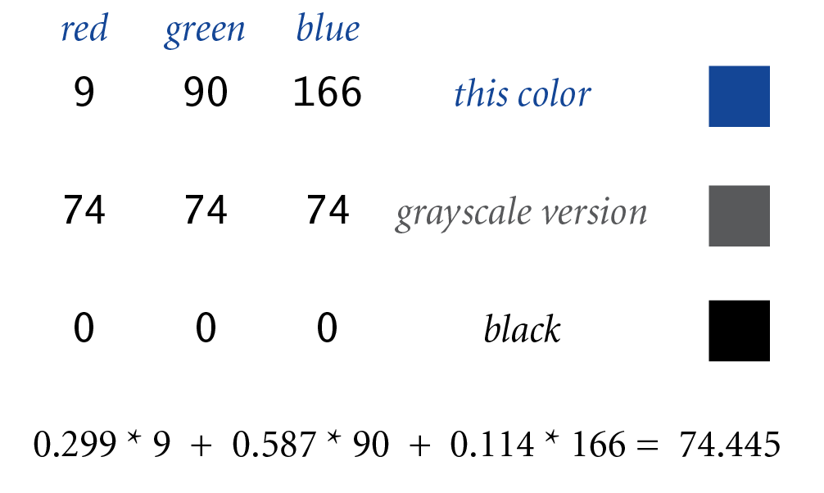
Grayscale
Grayscale. When all three R, G, and B values are the same, resulting color is on grayscale from 0 (black) to 255 (white).
Convert to grayscale. Use luminance to determine value.
Bottom line. We are writing programs that manipulate color.
public static Color toGray(Color c) {
int y = (int) Math.round(lum(c));
Color gray = new Color(y, y, y);
return gray;
}
round double to nearest long
Notes:
lum() returns a double so round using Math.round(). Math.round() returns a long, so need to cast to int
Bottom line: we can pass Color variables to functions, and return a Color value from a function

Slide 15
OOP Context for Color
Possible memory representation.
Object reference is analogous to variable name.
We can manipulate the value that it holds.
We can pass it to (or return it from) a method.
D0
D1
D2
D3
D4
D5
D6
D7
D8
255
0
255
0
0
0
105
105
105
A0
B0
magenta
gray
D0
D6
memory address ("pointer")

Slide 16
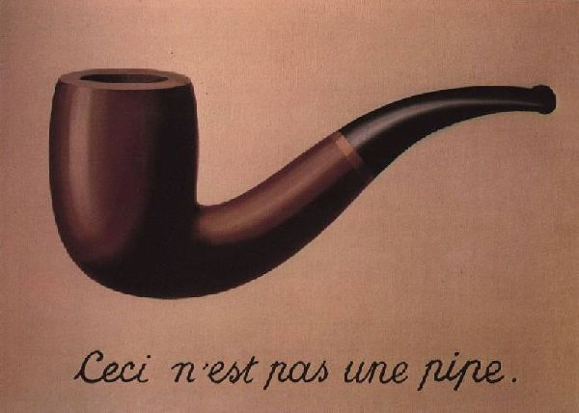
References
René Magritte. "This is not a pipe."
Java. This is not a color.
OOP. Natural vehicle for studying abstract models of the real world.
Color sienna = new Color(160, 82, 45);
Color c = sienna.darker();
Notes:
Rene Magritte pronunciation = runA' magrEt'
Magritte = famous 20th century Belgian surrealist painter. It isn't a pipe; it's a drawing of one. (well, actually a projected image of a JPEG file of a photograph of a painting of a pipe)

Slide 17
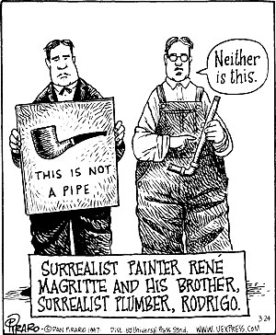
This is Not a Pipe
Neither is this.
% java RandomSeq 10000 | java Average
Dan Piraro, http://www.uexpress.com

Slide 18
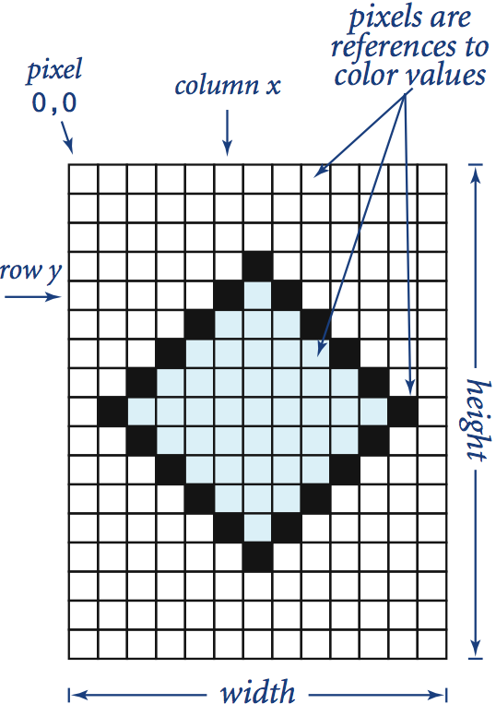
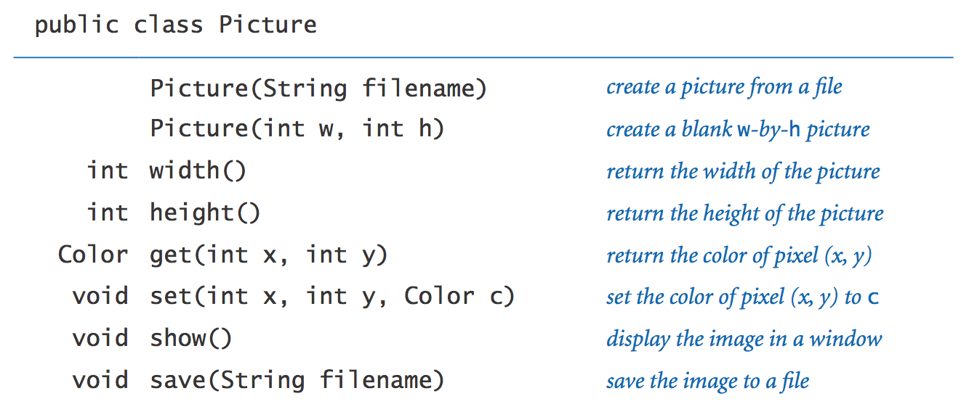
Picture Data Type
Raster graphics. Basis for image processing.
Set of values. 2D array of Color objects (pixels).
API.
Notes:
more complicated data type (Picture) composed from simpler data type (Color) composed from primitive data type (int).
Library developed for this course.

Slide 19
Image Processing: Grayscale Filter
Goal. Convert color image to grayscale according to luminance formula.
import java.awt.Color;
public class Grayscale {
public static void main(String[] args) {
Picture pic = new Picture(args[0]);
for (int x = 0; x < pic.width(); x++) {
for (int y = 0; y < pic.height(); y++) {
Color color = pic.get(x, y);
Color gray = Luminance.toGray(color);
pic.set(x, y, gray);
}
}
pic.show();
}
}
from before
Notes:
using luminance formula from before

Slide 20
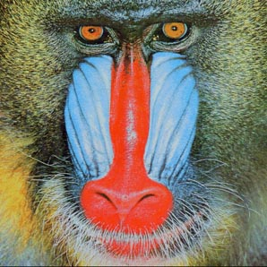
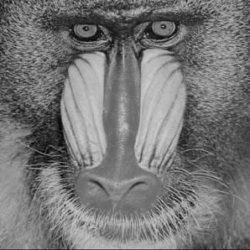
Image Processing: Grayscale Filter
Goal. Convert color image to grayscale according to luminance formula.
mandrill.jpg
% java Grayscale mandrill.jpg

Slide 21
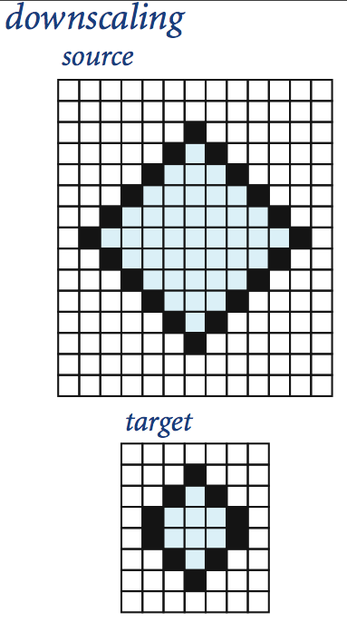
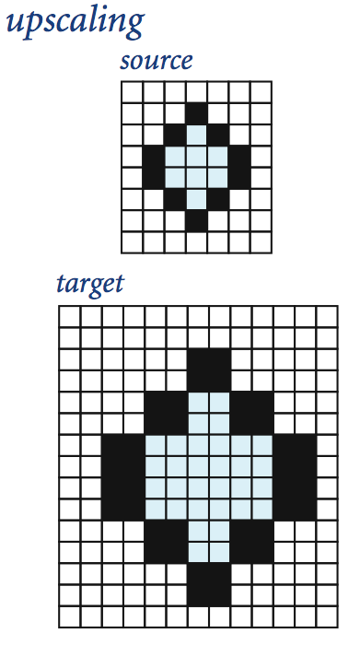
Image Processing: Scaling Filter
Goal. Shrink or enlarge an image to desired size.
Downscaling. To shrink, delete half the rows and columns.
Upscaling. To enlarge, replace each pixel by 4 copies.
Notes:
note: double the size = double the size in each dimension

Slide 22
Image Processing: Scaling Filter
Goal. Shrink or enlarge an image to desired size.
Uniform strategy. To convert from w_{s}-by-h_{s} to w_{t} -by-h_{t} :
Scale column index by w_{s} / w_{t} .
Scale row index by h_{s} / h_{t} .
Set color of pixel (x, y) in target image to color of pixel (x × w_{s} / w_{t} , y × h_{s} / h_{t} ) in source image.
x × w_{s} / w_{t}
x
y × h_{s} / h_{t}
?
y
source image (w_{s}-by-h_{s})
target image (w_{t}-by-h_{t})

Slide 23
Image Processing: Scaling Filter
import java.awt.Color;
public class Scale {
public static void main(String[] args) {
String filename = args[0];
int w = Integer.parseInt(args[1]);
int h = Integer.parseInt(args[2]);
Picture source = new Picture(filename);
Picture target = new Picture(w, h);
for (int tx = 0; tx < target.width(); tx++) {
for (int ty = 0; ty < target.height(); ty++) {
int sx = tx * source.width() / target.width();
int sy = ty * source.height() / target.height();
Color color = source.get(sx, sy);
target.set(tx, ty, color);
}
}
source.show();
target.show();
}
}
Notes:
integer division to compute (si, sj) - maybe round instead

Slide 24


Image Processing: Scaling Filter
Scaling filter. Creates two Picture objects and two windows.
mandrill.jpg
% java Scale mandrill.jpg 400 200
(298-by-298)

Slide 25
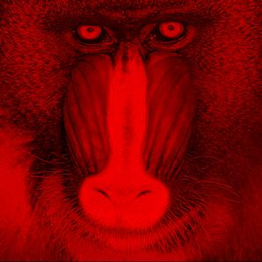
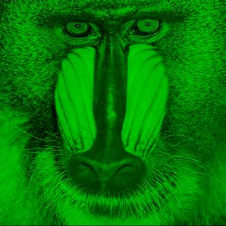
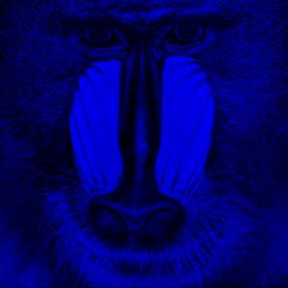
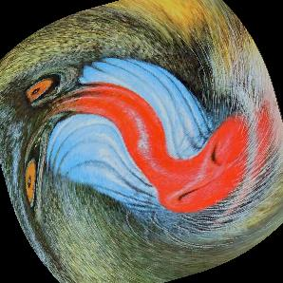
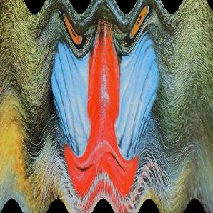

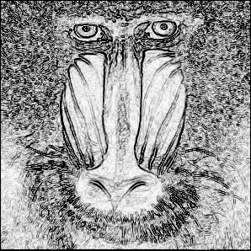
More Image Processing Effects
RGB color separation
swirl filter
wave filter
glass filter
Sobel edge detection

